Slide 1
Capstone Project1:
Suggesting the right product prices making use of regression models
SWATI ACHARYA
PGAA05

Slide 2
PROBLEM STATEMENT:
To build an algorithm which would help in suggesting right product prices from product name, category name, brand name, item condition and shipping information.
Objectives:
Data Cleaning
Visualization to draw the insights about the data
Feature Engineering
Using various machine learning algorithms
Data Description:
The columns are train_id, name, item_condition_id, category_name, brand_name, price and shipping
There are around 150000 data elements
Models Used:
Linear Regression
Ridge Regression
Lasso Regression
Stochastic Gradient Descent
Brief about the Models:
In this case, regression models has been used as it is a continuous data where we need to predict what could be the right product prices on the basis of independent variabes (item_condition_id, shipping, cat_name, brdname, sub1_name and sub2_name). The dependent variables is price. The train/test split has been done accordingly after one hot encoding and then various models has been run.
The linear regression works on the basis of principle where it tries to give best fit line where RMSE is minimum possible, however, the error was quite high for test data thereby the regularization methods which comprises of L1 & L2 (Ridge & Lasso) has been performed and SGD has also been performed which reduced the error manifolds.

Slide 3
Regularisation is a form of regression that constraints/regularizes or shrinks the coefficient estimates to zero. It helps in reducing overfitting. This overfitting is a problem when a statistical model fits exactly its training data.
Ridge Regression (L2 Regression) adds squared magnitude of coefficient as penalty term to the loss function and Lasso Regression (L1 Regression) adds absolute value as penalty term. Both these regularization models make use of shrinking parameter represented by lambda ( λ ). When λ =0 ridge regression equals the least square regression model and when λ = infinity , the coefficients shrink to 0. So the main aim is to obtain proper value for λ since on increasing the λ the error would also get increased.
Stochastic Gradient Descent is another method to optimize the model where its making using of learning rate as the parameter. The learning rate has to be carefully chosen as a very high learning rate would result in overshooting the minimum error. This method uses a randomly selected subset of data at every step rather than full dataset.
CONCLUSION:
RMSLE is very high for linear regression model, which led to the usage of regularization and SGD for optimization of the model. Following which, ridge regression was capable of giving least error and thereby could be used for suggesting the right product prices .

Slide 4
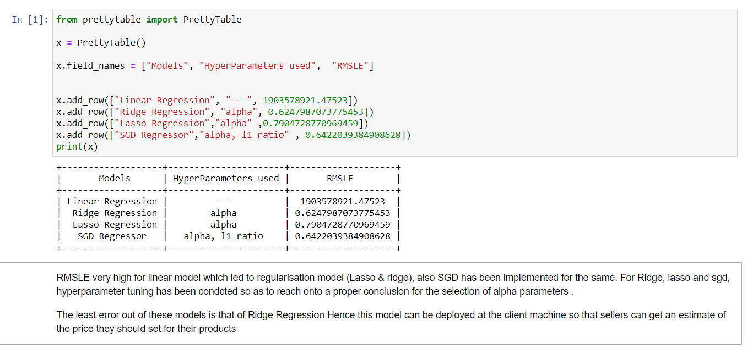
Visualization:
Visualization of the final result is as follow:

